Slide 1
‘TASTIC TOASTS
One of the most important meals of the day

Slide 2
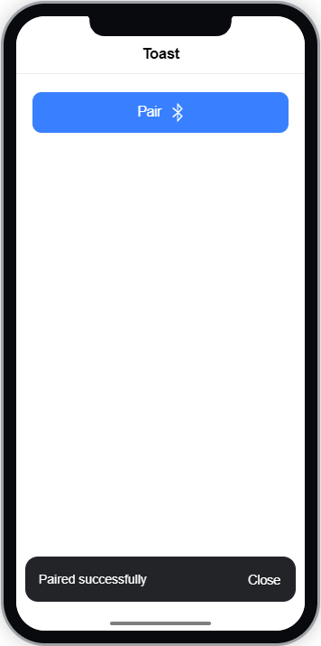

‘Tastic Toasts
Toasts are small, inobtrusive pop-up alerts that feedback to the user about in-app events.
A toast is another example of a dynamic component.
Toasts appear above any other app content and can be customised to the same look and feel as the app or left as they are to blend in with the phones OS.
Toasts are controlled in the same way as Alerts, by using a Toast Controller

Slide 3
Toast Controller
There are two ways in which we can show a toast pop-up
presentToast()
presentToastWithOptions()
There’s also more cool things we can do with the Toast Controller such as:
Dismiss – get rid of the toast
getTop – get’s the last popped toast
For our delivery app, we are going to look at how show the toast with a change of the options.

Slide 4
CHALLENGE TIME!
Create a toast for your mobile app.
For bonus points, use the Ionic Docs to find and change the toast options.
For bonus, bonus points, get the last toast you popped too!
Share a screen shot on our Discord Community!

